Slide 1

CCPS 305
Data Structures and Algorithms

Slide 2

Instructor
Dr. Jimmy Tran
q2tran@ryerson.ca
Office: ENG-209

Slide 3
When Contacting…
Please put CCPS305 in the subject line
Include your full name (first and last) and your section number.
Contact using only your Ryerson email address (No Gmail, Hotmail, Yahoo..)

Slide 4
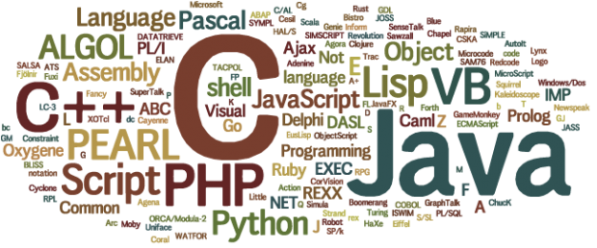
You
Previous programming experience?

Slide 5
Prerequisites
CPS109/209

Slide 6
Description
The course will present both a theoretical and practical treatment of introductory-level data structures and associated algorithms as related in the course text. The algorithms are expressed as pseudo-code so that it is agnostic of programming language
Learning Outcomes:
The student will be able to identify, create, implement, employ, manipulate, and reason about the data structures and algorithms studied, within the context of the procedural paradigm. The student will be able to solve the problems from the text, from class and labs, other similar problems, and those that build upon them

Slide 7
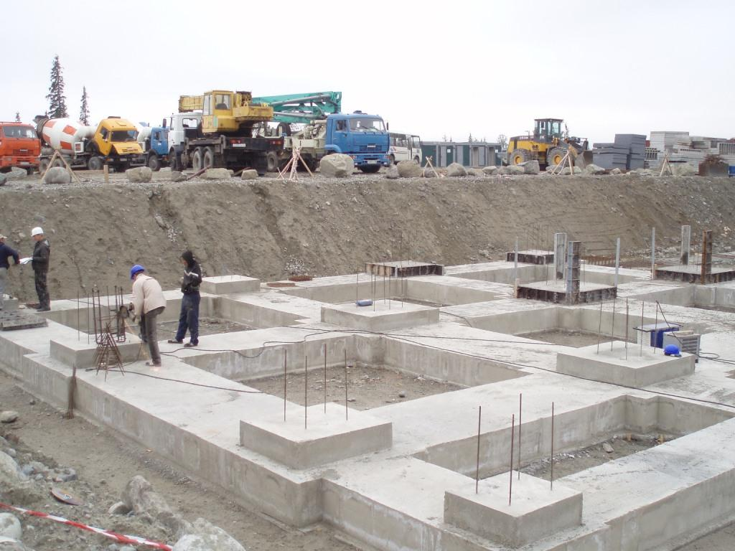
Foundation of Computer Science

Slide 8
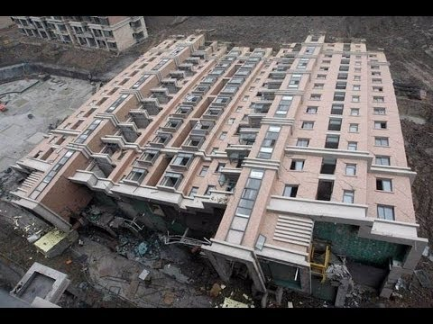
Importance of Foundation

Slide 9
Evaluation:
Term Test 1: 15%
Term Test 2: 15%
Final Exam: 25%
5 Labs: 5 x 5% = 25%
2 Assignments: 2 x 10% = 20%

Slide 10
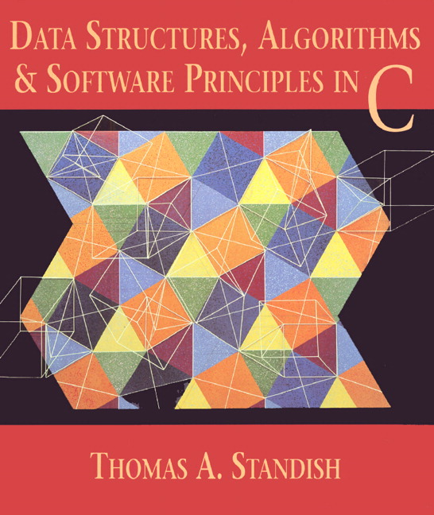
Course Textbook

Slide 11
Topics
Introduction (C1)
Primitive Data Types
Abstract Data Types
Motivation
Review of C Essentials (C2)
Pointers
Structures
Dynamic Memory Allocation
Recursion (C3, C14.1, C14.2)
Call Traces and Call Trees
Divide-and-Conquer Decompositions
Tail Recursion
Infinite Regress
Simple Analysis
Dynamic Programming
Complexity (C6)
Complexity Classes
Big-O Notation
Time Complexity
Space Complexity
Complexity Trade-offs
Hashing (C11)
Basic Concepts
Hashing Functions
Collision Resolution
Sorting (C13)
Divide-And-Conquer Methods
Insertion-Based Methods
Address-Calculation Methods
Priority-Queue Methods
Other sorting
Analysis and Comparisons
Graphs (C10)
Introduction
Representations
Searching
Topological Ordering
Shortest Paths
Task Networks
Applications
Linear Lists (C8.1-C8.4)
Single-linking
Multiple-linking
Applications
Restricted Linear Lists (C7)
Stacks
Queues
Dequeues
Applications
Trees (C9)
General Trees
Binary Trees
Binary Search Trees
B-Trees
Tries
Huffman Codes (and Greedy Algorithms)
Heaps
Analysis and comparison

Slide 12
Data Sources

Slide 13
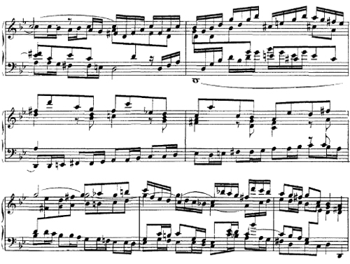
Data Sources

Slide 14
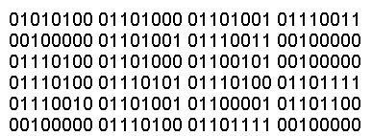
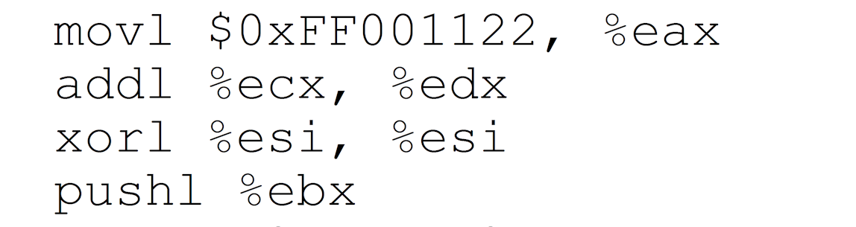
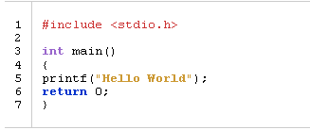
Background
Machine code (pure binary):
Assembly Language: Tediious, still tied to computer architecture.
High Level Languages (C, C++, Java, etc.): Easier to understand, faster implementation time

Slide 15
Primitive Data Types
Most “basic” types in HLLs
Vary among HLLs
Typically: integer, character, Boolean floating point(real)

Slide 16
Data Structure
More complex representation of data
“Built-up” from primitive data types
Examples:
Arrays … from … ints, floats etc.
Complex Numbers … from … ints 4+7i
Tree, Stack, etc.

Slide 17
Abstract Data Type (ADT)
Data structure + operations for it
Example: Complex Numbers, ops: +,-, x, conjugation
Idea: Use ADT like primitive types
Examples:
Complex A, B, C
A = (1, 4)
B = (2, 7)
C = A +B
String C, A, B = (1, 2, A, C)
A = cdr(B)
C = concatenate(A, B)

Slide 18
ADTs in C
Languages such as Java, Scala, Python directly support ADTs
C implements ADTs with:
Data structures
Program-defined operations for them Example: String ADT has ops: strcat, strlen, etc.

Slide 19

Why use DSs, ADTs?

Slide 20

In Computer Science DS and ADTs

Slide 21

Motivation

Slide 22


Slide 23
Topics
Introduction (C1)
Primitive Data Types
Abstract Data Types
Motivation
Review of C Essentials (C2)
Pointers
Structures
Dynamic Memory Allocation
Recursion (C3, C14.1, C14.2)
Call Traces and Call Trees
Divide-and-Conquer Decompositions
Tail Recursion
Infinite Regress
Simple Analysis
Dynamic Programming
Complexity (C6)
Complexity Classes
Big-O Notation
Time Complexity
Space Complexity
Complexity Trade-offs
Hashing (C11)
Basic Concepts
Hashing Functions
Collision Resolution
Sorting (C13)
Divide-And-Conquer Methods
Insertion-Based Methods
Address-Calculation Methods
Priority-Queue Methods
Other sorting
Analysis and Comparisons
Graphs (C10)
Introduction
Representations
Searching
Topological Ordering
Shortest Paths
Task Networks
Applications
Linear Lists (C8.1-C8.4)
Single-linking
Multiple-linking
Applications
Restricted Linear Lists (C7)
Stacks
Queues
Dequeues
Applications
Trees (C9)
General Trees
Binary Trees
Binary Search Trees
B-Trees
Tries
Huffman Codes (and Greedy Algorithms)
Heaps
Analysis and comparison

Slide 24
Questions?

